Slide 1
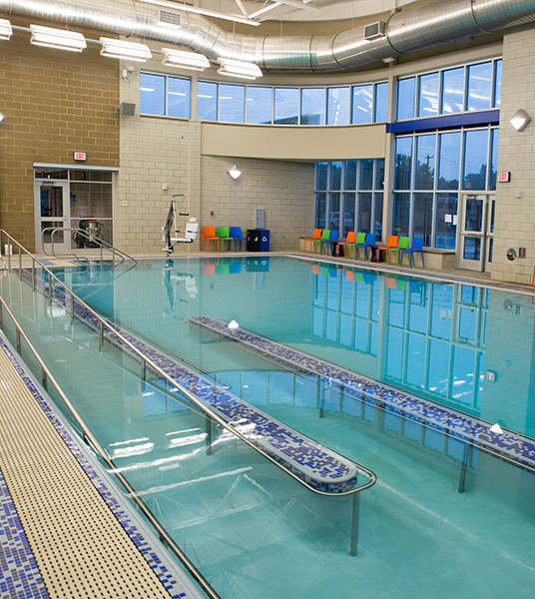

Aquatic Centres and Heat Pumps: a good match?
Alan Pears AM
Senior Industry Fellow, RMIT
Fellow Climate and Energy College, University of Melbourne
Technical Director Aust Alliance for Energy Productivity
Local Government Workshop
Online 7 May 2020

Slide 2
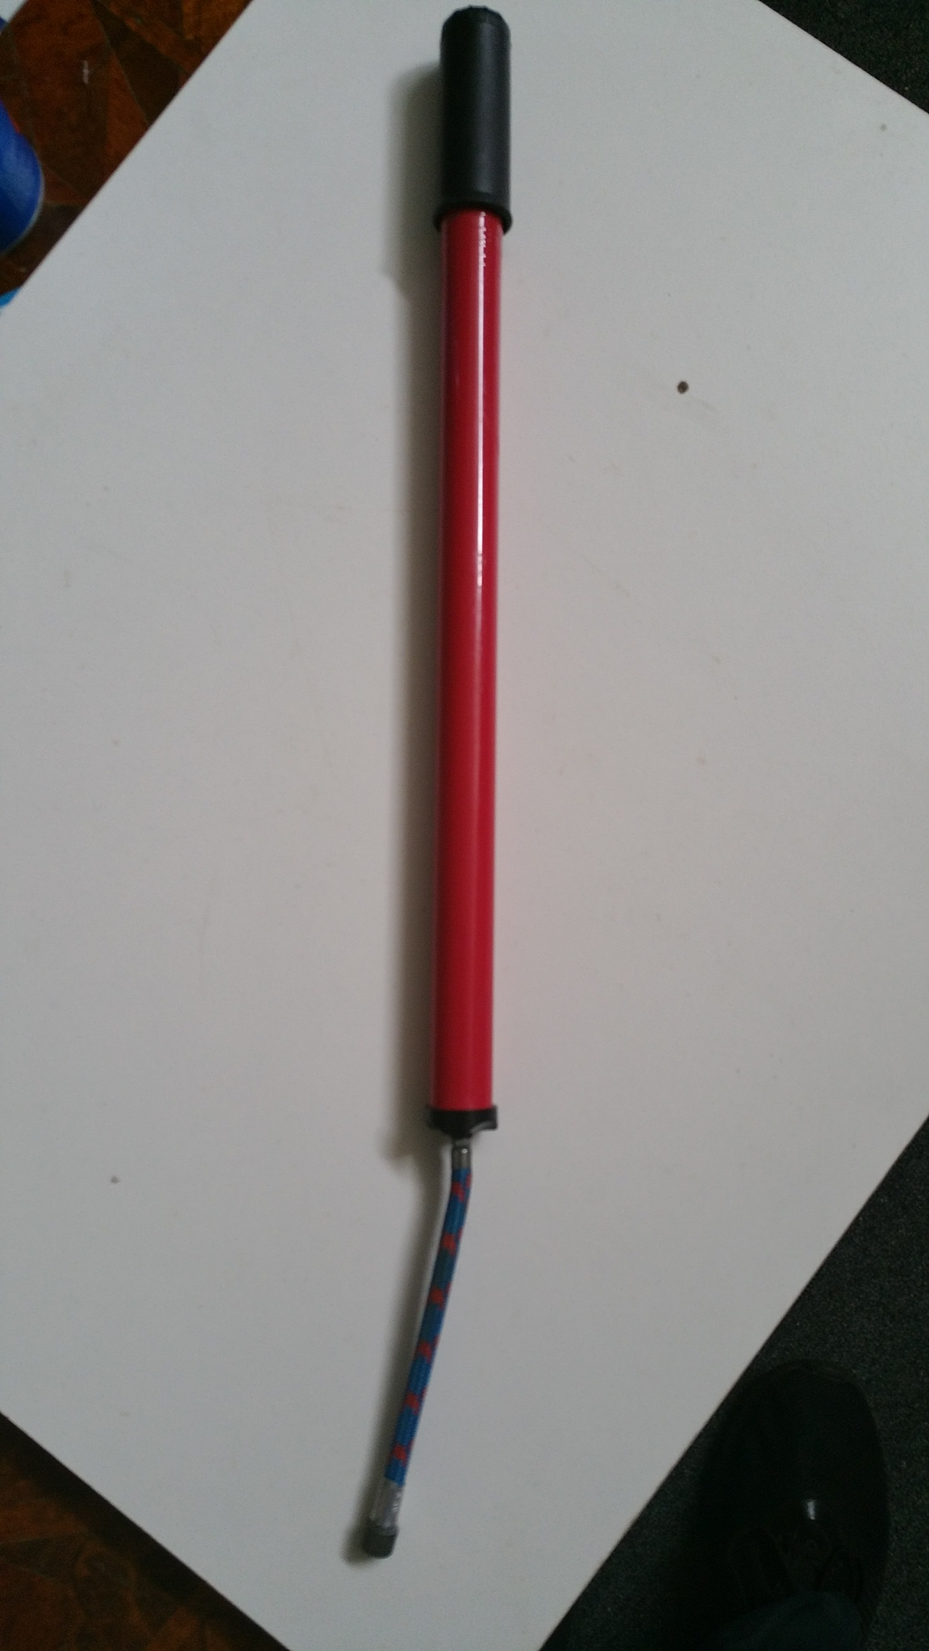
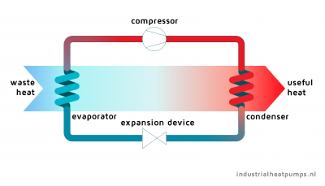
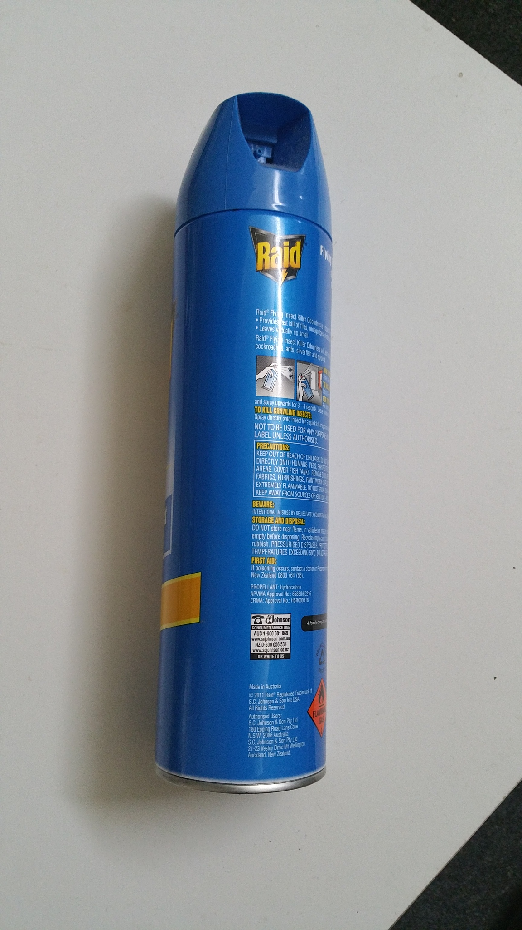
How does a Heat Pump Work ? Principles and everyday examples of processes
Source of graphic: De Kleijn 2017, www.industrialheatpumps.nl
Everyday example: bike pump heats up air as it compresses it
Thermodynamics: heat (energy) content of a substance has zero energy baseline at zero degrees Kelvin (Absolute Zero) minus 273 degrees Celsius. So a ‘cold’ substance at minus 20C (253K) is really HOT and contains a lot of energy
Low pressure gas
Hot high pressure gas
Electricity input
303⁰K (30⁰C)
273⁰K (0⁰C)
253⁰K (-20⁰C)
0⁰K (-273⁰C)
Everyday example: steam condenses to water as it cools, releasing heat
Everyday example: puddle of water is warmed up and evaporates as it absorbs heat from surroundings, sun and wind
Cold liquid
Liquid
Everyday example: liquid under pressure in spray can is released – becomes colder

Slide 3
Roles of heat pump in aquatic centre
Electricity input
HEAT SOURCES
Warm, humid exhaust air (including energy from condensing water vapour)
Ambient heat from outdoor air, water, ground
Cooling and dehumidification of building
USES OF HEAT
Pool water
Domestic hot water
Building heating
Thermal storage
Heat pump efficiency can be 200% to 1000% (or more!) – ratings use Coefficient of Performance (COP) or Energy Efficiency Ratio 2 to 10 units of energy per unit of electricity consumed. Efficiency depends on system design and temperature difference between evaporator and condenser

Slide 4
Everyday example of heat pump recovering energy from humid exhaust air: heat pump clothes dryer
Water vapour contains a lot of energy: each litre of water evaporated contains ~2.4 megajoules (2/3 kWh) of heat, assuming no heat recovery – a steam burn is much worse than a hot water burn
Actual humidity of aquatic centres 50-60%

Slide 5
Aquatic centre energy flows – not so simple... (Source: Trianti-Stourna et al 1998)
Pool heating:
Heats up water
Warm pool surface heats up pool hall – 100-400 watts/square metre of pool depending on humidity, pool and pool hall temperatures and air movement
Evaporates water that humidifies and heats pool hall air
Pool loses some heat to surrounding earth
Also:
Energy losses from heat production (eg gas boiler flue losses) and delivery equipment (pipes, valves etc)
Fans, pumps, lights and equipment – high electricity use also creates heat
Temperature and heating/cooling energy use of pool hall also depends on building fabric thermal performance and active ventilation rate: Passivehaus experts advocate excellent building fabric performance
‘Waste’ cooling from heat pump can be used to cool building
Heat recovery from exhaust air

Slide 6
THE END
Thankyou for your time

Slide 7
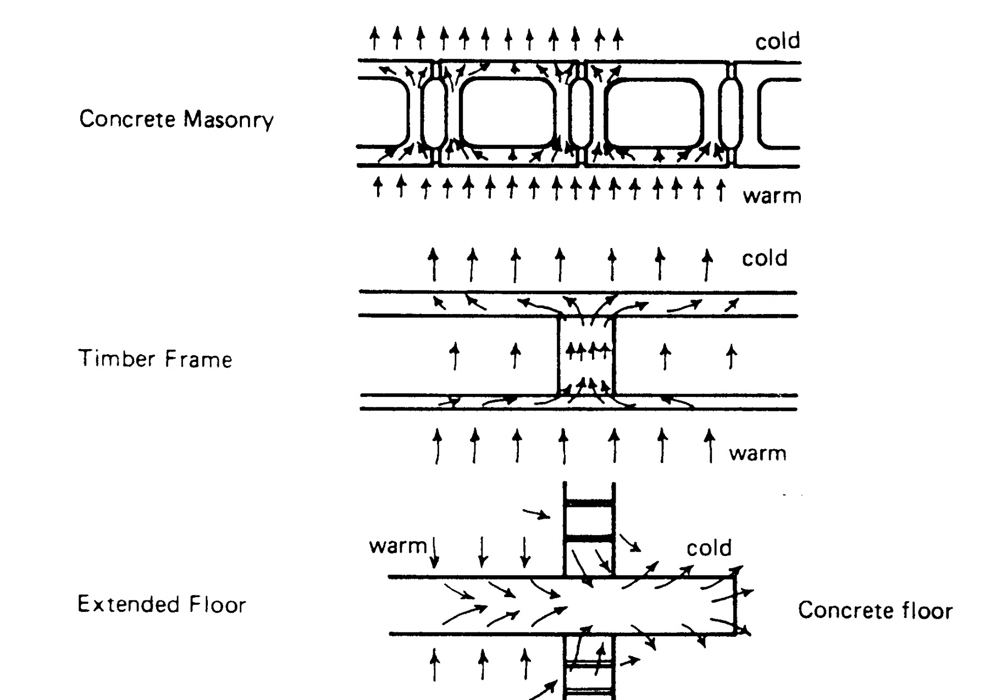
Thermal performance of building fabric is very important
Glazing – see next slide
Insulation+ minimise thermal bridging through framing etc to cut heat flow and change temperatures of surfaces closer to room temperature, reducing condensation risk
Tight fabric to minimise uncontrolled air leakage
Other issues such as
Limit evaporation with:
  Careful temperature and humidity management
  Minimum air movement across pool surface
  Pool blankets, films etc
Optimise outdoor air supply to consider:
  Indoor environment quality – limit emissions vs increased ventilation or air purification
  Alternatives – dehumidification vs energy recovery from exhaust air and fan energy use
  Manage internal air flows

Slide 8
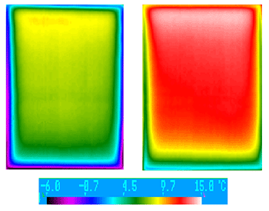
Glazing
Factors affecting heat flows through glazing:
Solar radiation
Conduction, Convection or forced air movement on inside surface of window – reduces thermal resistance of ‘still air’ film
Wind – increases heat transfer between glass and outdoor air
Condensation on glass – every litre of water condensing releases ~ 2.4 megajoules of heat into glass, mostly dumped to outdoors
Thermal bridging through window frames and support structures
High thermal performance glazing (and fabric insulation) mean temps of surfaces are higher so building can run at higher humidity without condensation problems, reducing evaporation from pool
Indoor temperature of low-e and standard double glazing at -18C – std DG covered in condensation
https://www.efficientwindows.org/condensation.php

Slide 9
Outdoor pools
From a base of 3m/sec wind speed and 25C pool temperature in Melbourne (using 1970s CSIRO model), indicative factors are:
1 metre/second change in wind speed changes energy required by ~23%
1C change in pool temperature changes energy required by ~10%
So protection from wind, use of a pool cover (or equivalent) and temperature setting, are very important.
Strategically placed pool shading may also reduce wind impact.
Management of solar radiation can help to optimise pool temperature and reduce heating

Slide 10
Misc bits and pieces of info
Eg of pressure affecting boiling point. Water boils at 71C at top of Mt Everest because the air pressure is a lot lower.
For a gas PV=nRT
Each litre of water evaporated from pool contains ~2.4 megajoules (2/3 kWh) of heat, assuming no heat recovery
For a gas boiler (system efficiency 60-90% gas price $15/gigajoule) that’s $40-60 per kilolitre
For electric heat pump (system COP 3-10, electricity price $10 – 20/MWh that’s $7-22 per kilolitre) – but higher capital cost
Calcs heat of vaporisn from https://www.engineeringtoolbox.com/water-properties-d_1573.html?vA=25&units=C
  20C=2.454 MJ/degC; 25C=244.1; 30C=2.43
Max saturation of water vapour from https://www.engineeringtoolbox.com/humidity-ratio-air-d_686.html
  20C= 0.0146 25C 0.01983 30C 0.02713
Evaporation of water from surface https://www.engineeringtoolbox.com/evaporation-water-surface-d_690.html
  for 0.5 m/sec air speed: 20C g_{s} = (34.5 kg/m²h) (1000 m²) ((0.014659 kg/kg) - (0.0098kg/kg)) / 3600 = 0.047 kg/sec for 1000m2 area =115W/m2 25C (0.019826 kg/kg)=235W/m2 30C (0.027125 kg/kg)=405W
  For 0.2 m/sec 20C=95W/m2; 25C=196W/m2; 30C=339W/m2

Slide 12
If saturated air (100% humidity) is cooled from 35C to 15C, 87 kilojoules/kg (73 kJ/cubic metre) of heat energy can be recovered
REALITY CHECK spreadsheet data with Amna
Pool hall say 60m by 20m by 10
vol m3 | 12000
Airch/h | 5 |  |  | COP | 5
tot vol | 60000 |  |  | elect | 242.6389 | kW
en/m3 | 0.072792 | MJ/m3 for 35 to 15C |  | $/kWh | 0.15
MJ/hour | 4367.5 |  |  | elect | 36.39583 | $/hour
gas eff | 0.8
gas cons | 5.459375 | GJ/h
gas cost $/GJ | 15
 | 81.89063
gas ghgs | 294.8063

